Slide 1
Selectional Preference and Sense Disambiguation by Philip Resnik
BioNLP Journal Club
Sept 24th, 2014.
Negacy Hailu
Notes:
Today I am going to talk on selection preference and sense disambiguation.
Also,
My research interest
High level specific aims

Slide 2
Research Area of Interest
Semantic Parsing with Combinatory Categorial Grammars (CCG)
Statistical characterization
Closure property
Zipf’s law
Over-represented words
Measure of vocabulary similarity/difference using KL divergence
Lexical acquisition:
Collocation/Term acquisition
Selectional restrictions with semantic classes
Notes:
Research area of interest
Potential specific aims
Mostly on the meaning of language in biomedical domain
Ranges from words to sentences and even to corpus
Semantic parsing workshop: http://sp14.ws/

Slide 3
Semantic Parsing with CCG Task 1
Slide from Artzi et al.
Notes:
Semantic parsing are used to extract meaning from language.

Slide 4
Task 2
Slide from Artzi et al.

Slide 5
Task 3
Slide from Artzi et al.

Slide 6
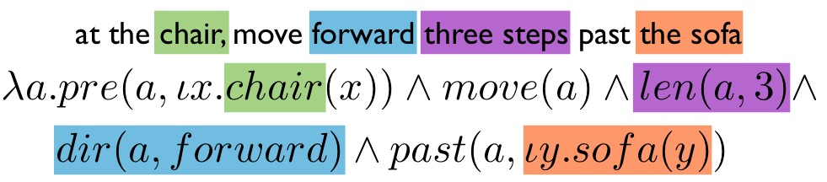
Task 4
Slide from Artzi et al.

Slide 7
Central problems in Semantic Parsing
Yoav Artzi, Nicholas FitzGerald and Luke Zettlemoyer: Semantic Parsing with Combinatory Categorial Grammars. ACL 2013 Tutorial.
Yonatan Bisk and Julia Hockenmaier An HDP Model for Inducing Combinatory Categorial Grammars Transactions of the Association for Computational Linguistics Vol 1. 2013
Yonatan Bisk, Julia Hockenmaier: Simple Robust Grammar Induction with Combinatory Categorial Grammars. AAAI 2012
Steedman M. 2000. The Syntactic Process. MIT press.
Notes:
Parsing:
Grammar formalism
Inference procedure
Learning:
Modeling:
What logical language to use?
How to model meaning?

Slide 8
Corpus analysis
Statistical characterization
Closure property
Zipf’s law:
Over-represented words
Measures of vocabulary similarity/differences using KL divergence.

Slide 9
Closure property to study corpus analysis
Irina Temnikova and K. Bretonnel Cohen (2013)
Notes:
Closure properties: tendency of a genre of a language towards finiteness. The research question that they ask is if there is a difference between domain specific corpus and general corpus like BNC.

Slide 10
Corpus analysis related research questions
I am interested in the following questions:
Does document size affect closure properties/zipf’s law?
How large of a sample size is required to do corpus analysis?
Can we numerically measure closure properties and Zipf’s Law?

Slide 11
Lexical acquisition
Goal of lexical acquisition as in
“To develop algorithms and statistical techniques for filling the holes in existing dictionaries and lexical resources by looking at the occurrences of patterns of words in large text corpora” Manning and Schütze Stat NLP.
Lexical acquisition problems:
Collocations
Selectional preferences
Semantic similarity
Notes:
Selection preference

Slide 12
Selectional Preferences
Most verbs prefer arguments of a particular type: selectional preference or restrictions
Objects of eat tend to be food
Subjects of think tend to be people …
“Preferences” to allow metaphors
Fear eats the soul
How is this important in NLP?

Slide 13
Applications of Selectional Preferences in NLP
To infer meaning from selectional restrictions
Suppose we don’t know the word “durian” (the word is not available in the vocabulary)
Susan ate a very fresh durian.
We can infer that durian is a type of food.
Ranking the possible parses of a sentence:
Give higher scores to parses where the verb has “natural argument”.

Slide 14
Models of selectional preferences
Selectional preference strength
How strongly the verb constrains its direct object
E.g. eat, find, see
Selectional association
Between the verb and the object semantic class
E.g. eat and food

Slide 15
Selectional Preference and Sense Disambiguation by Philip Resnik
Motivation of the paper:
Absence of training data is big problem for corpus-based approaches
Statistical model of selectional preferences in sense disambiguation.
Word Sense Disambiguation (WSD)
E.g. Mary drank burgundy
Burgundy means color. It also means any of various wines.

Slide 16
Selectional preference in probabilistic terms
The difference between the prior distribution and posterior distribution is the selectional preference
Selection preference strength
of a predicate. KL divergence.
Notes:
Verb subject relationship for the nouns person and insect.

Slide 17
Selectional Association
Defined as
E.g.
Susan interrupted the chair.
Chair could mean people as in chairperson. It could also mean a furniture.

Slide 18
Example from Stat NLP book (Manning and Schütze)
Notes:
Eat prefers food as an arguments
See distribution is the same as the prior
Find dis-prefers action.
From S(V) at the bottom of the table, eat is very specific. See is not specific and find is less specific.

Slide 19
Research Area of Interest
Semantic Parsing with Combinatory Categorial Grammars (CCG)
Statistical characterization
Closure property
Zipf’s law
Over-represented words
Measure of vocabulary similarity/difference using KL divergence
Lexical acquisition:
Collocation/Term acquisition
Selectional restrictions with semantic classes
Notes:
Research area of interest
Potential specific aims
Mostly on the meaning of language in biomedical domain
Ranges from words to sentences and even to corpus
Semantic parsing workshop: http://sp14.ws/

